Slide 1

Hiring a Lead Data Scientist
Finding a Competitive Salary Range

Slide 2
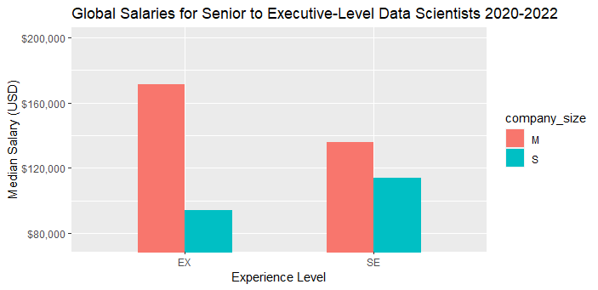
Searching for Experience
Median salary for Executive-level experience in a mid-sized company >$20,000 more
Only 2 data entries for Executive-level data scientist at small-sized companies
May not be accurate reflection of industry standard
Senior-level experience is considerable cheaper and likely more appropriate for needs of driving data science and developing workflows

Slide 3
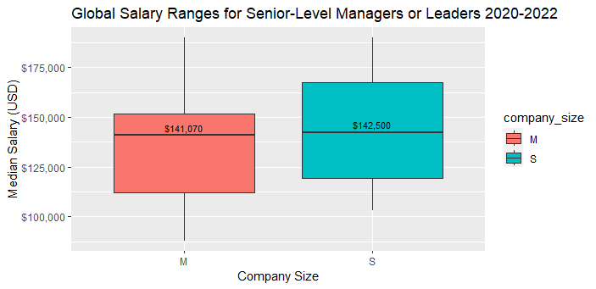
Staying Competitive with Growth
Looking specifically at senior-level data scientists with managerial or team-leading experience
Salary ranges are comparable between mid-to-small-size companies
Setting a range for a lead data scientist now will translate as the company grows in the future

Slide 4
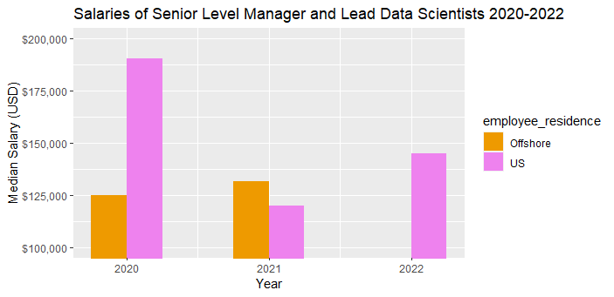
Changing Wages 2020-2022 by Residence
In 2020, the median salary for US-based lead data scientists in small-to-mid-sized companies was significantly greater than that of offshore-based lead data scientists
Large reduction in salary for US-based in 2021; offshore-based increased slightly
Increase in salary for US-based from 2021 to 2022; no data for offshore in 2022
Data is limited and cannot accurately demonstrate how wages will change year-to-year or if offshore employment consistently costs more or less than US employment

Slide 5
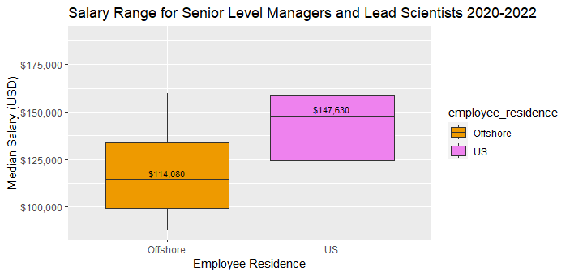
US vs Offshore: 2020-2022
Based on 2020-2022 data, US-based senior-level data scientists with leadership experience in small-to-mid-sized companies make over $33,000 more than offshore-based scientists with the same experience in similar-sized companies
Recommended salary range: $115,000 - $148,000
Dependent on experience and location
Will attract most offshore data scientists with experience and expertise to drive data science workflow and lead a team the future
Reaches to the median salary of US-based data scientists to attract bottom 50% of earners looking for new opportunity and growth

